Slide 1
Proxy & Framework
Bangalore, 28/08/2019, Prudhvi Kumar

Slide 2
Proxies
Proxy objects implement message interfaces from Integration Repository. Proxies are executable interfaces, which converts non-language-specific interface descriptions into WSDL. i.e., you use proxies to implement the actual message exchange that is described in the Integration Builder.
Types of Proxy objects: You can use message interfaces to create the following proxy objects:
ABAP Proxy objects
JAVA Proxy objects

Slide 3
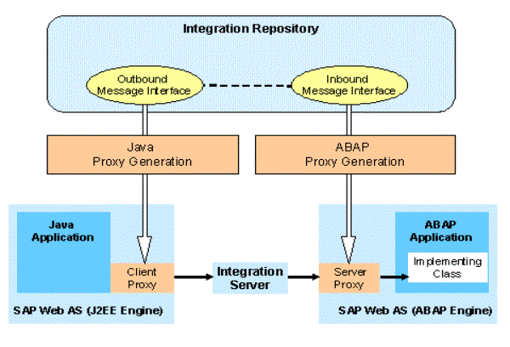
During the process of ABAP proxy generation, it gets WSDL (Web Service Description Language) description of message interfaces from the Integration Repository by using HTTP communication.

Slide 4
Proxy Generation
As part of SAP Web AS 6.40
ABAP proxy generation enables you to generate proxies to communicate by using the Web service infrastructure and by using SAP Exchange Infrastructure
ABAP proxies that were generated from message interfaces in the Integration Repository (IR) can be used in both infrastructures.
This means that if none of the Integration Server services are available for a proxy-to-proxy communication scenario in ABAP, you can use a point-to-point connection using the Web service infrastructure instead.

Slide 5
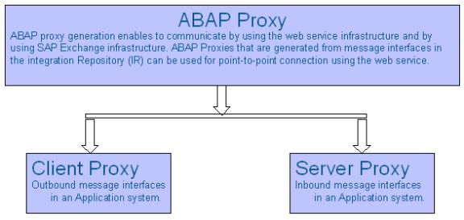

Slide 6
The prerequisites to configure ABAP Proxy include: (landscape dependent)
The business systems should be based on SAP Web AS 6.20 and SAP Web AS 6.20 kernel patch level above 1253
You have installed the XI Add-On in each of these business systems as described in the Installation Guide SAP Exchange Infrastructure 3.0
The business systems and your central Integration Server are maintained in the System Landscape Directory (SLD).

Slide 7
RFC Adapter
The RFC adapter enables you to use the functions of the Integration Engine or PCK in existing SAP system landscapes.
The adapter is used by SAP systems to connect to the Integration Engine or the PCK by using the RFC interface.
The adapter uses the SAP Java Connector (JCO), making use of its ability to manage metadata. This in turn enables you to map RFC data generically to RFC XML and the other way around.
RFC Adapter converts the incoming RFC calls to XML and in turn XML messages to outgoing RFC calls in case if the destination system is SAP.
RFC Adapter is installed on the J2EE Adapter Engine and can be monitored via Adapter Monitoring and Communication Channel Monitoring in the Runtime Workbench.
We can have both synch (sRFC) and asynch (tRFC) communication with SAP systems
sRFC uses Best Effort and tRFC uses Exactly Once Quality of services.

Slide 8
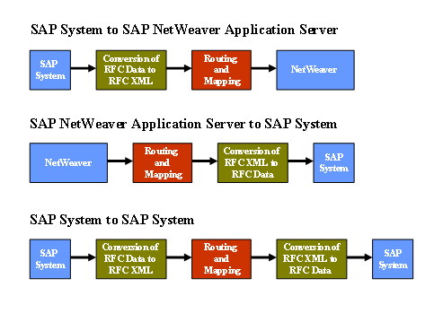
When can we use RFC Adapter

Slide 9
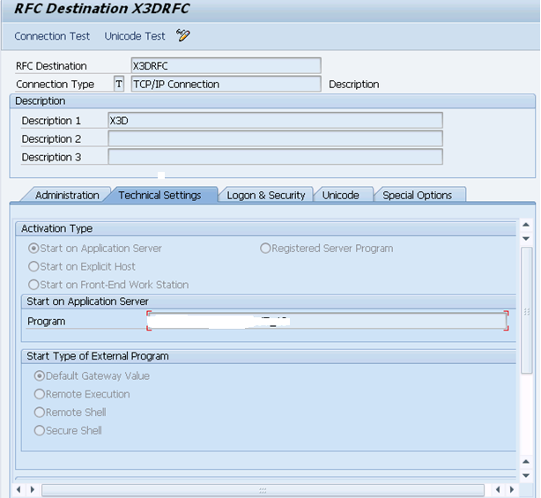
RFC Sender Adapter
Before configuring the sender RFC Adapter, first you need to create an RFC connection in SAP system.
Go to SAP system and open T-code SM59 and create a new RFC connection of type TCP/IP.
Now go to Technical settings tab and select Start of an Application server and in the Program, enter name to the Program ID you use.

Slide 10
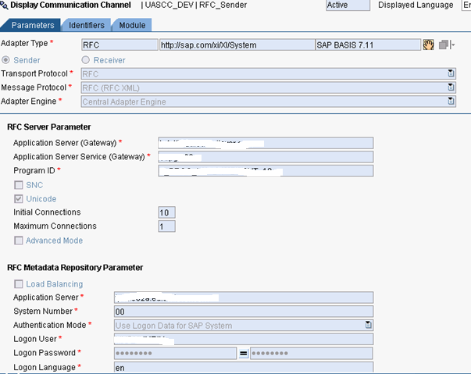
Same program ID should be given in the configuration of communication channel.
Create a communication channel in ID with RFC adapter and of type sender.
See the below screenshot for the sender RFC adapter configuration.

Slide 11
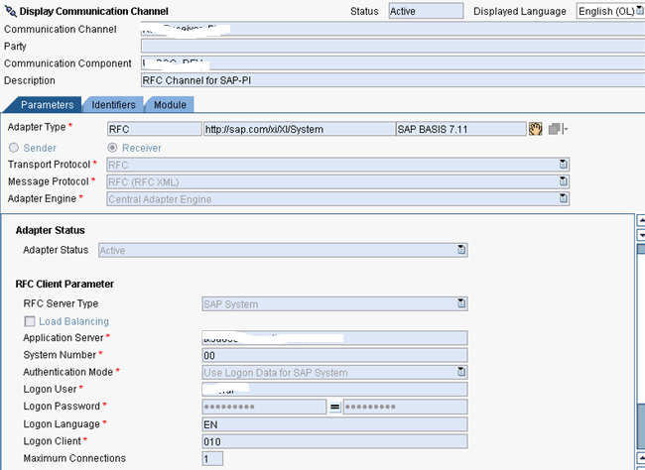
RFC Receiver Adapter
Create a communication channel in ID with RFC adapter and of type receiver.
Specify the RFC Client parameters like the Application server details, logon credentials and activate the channel.
See the below screenshot.

Slide 12
SOAP Adapter
The SOAP adapter enables you to exchange SOAP messages between remote clients or Web service servers and the Integration Server.
The receiver SOAP adapter also allows you to send SOAP messages using the SMTP protocol.
You can specify security settings to be used to sign/verify the SOAP body. In addition, you can specify the standard to be used for signing/verifying the SOAP message.
Procedure:
Create a communication channel in the Integration Directory.
To configure the adapter, choose the Parameters tab page.
Select SOAP as the Adapter Type

Slide 13
Sender SOAP Adapter
Configure the sender SOAP adapter to send content from remote clients or Web service servers to the Integration Server/Partner Connectivity Kit (PCK).
Procedure:
Select the Transport Protocol as HTTP .
If you want to send information from a remote client or a Web service server to the Integration Server/PCK, then select the Message Protocol as SOAP 1.1 . If you want to send an XI message from a legacy system or AAE through the SOAP Adapter, then select the Message Protocol as XI 3.0 .
Select the Adapter Engine on the Integration Server, or select a non-centrally installed Adapter Engine.
This selection is not available in the PCK.

Slide 14
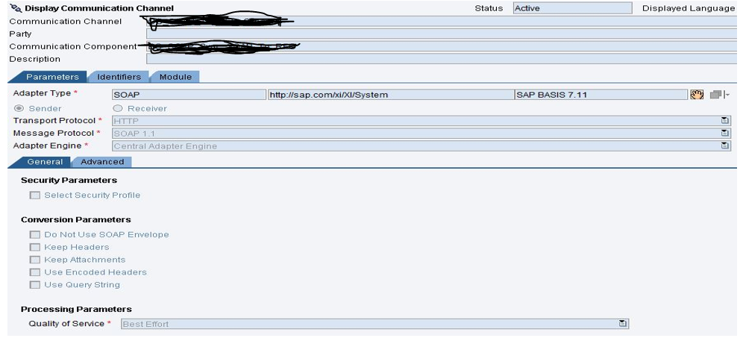
Sender SOAP Adapter

Slide 15
Receiver SOAP Adapter
You configure a receiver SOAP adapter to send information from the Integration Server/PCK to remote clients or Web service servers.
Procedure:
Select the Transport Protocol :
HTTP (including HTTPS)
SMTP (including SMTPS)
The adapter uses this transport protocol to send SOAP messages as e-mails.
If you want to send information from Integration Server/PCK to remote clients or Web servers, select the Message Protocol as SOAP 1.1 . If you want to send an XI message to a legacy system or AAE, then select the Message Protocol as XI 3.0 .
Using the XI 3.0 message protocol, you can, for example, configure the communication between the Advanced Adapter Engine and ABAP proxies generated in back-end systems. Note that there are restrictions when this option is used. For more information, see SAP note 1247043.
Select the Adapter Engine on the Integration Server, or select a non-centrally installed Adapter Engine.

Slide 16
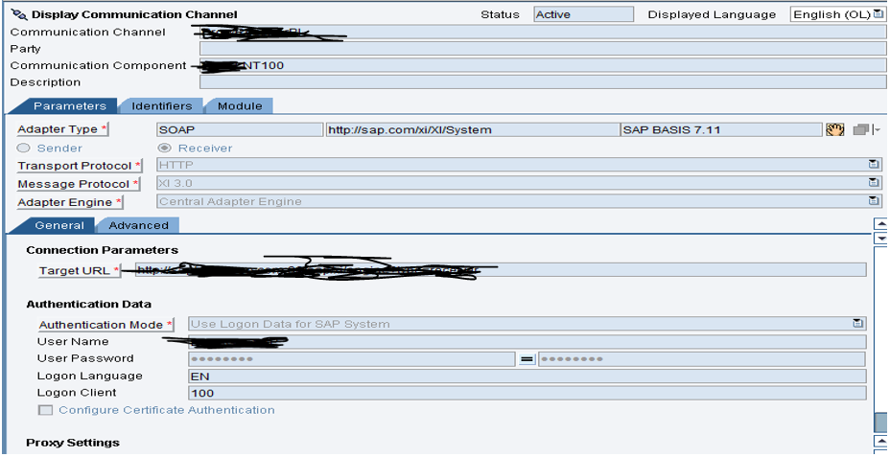
Receiver SOAP Adapter

Slide 17
IDOC Adapter
The IDoc adapter can also call external subsystems.
The SAP PI IDoc adapter is part of the Integration Server.
This adapter connects SAP components to the SAP Exchange Infrastructure by using IDoc communication.
The adapter translates XML and HTTP-based documents into IDocs, and then back into their original format.

Slide 18
Configuring the Sender IDoc Adapter
configure the sender IDoc Adapter to be able to process IDoc packages that come into the inbound channel of the Integration Server further using the Integration Engine.
Procedure :
The transport protocol is IDoc .
The message protocol is IDoc .
The Adapter Engine is the Integration Server .
To be sure that only those fields that relate to the release are transferred from each segement, enter the release under segment version.
If you also want to forward IDoc packages using the IDoc Adapter, choose IDoc Packaging .
Under IDoc Package Size specify the maximum for how many IDocs can be put into an IDoc XML.

Slide 19
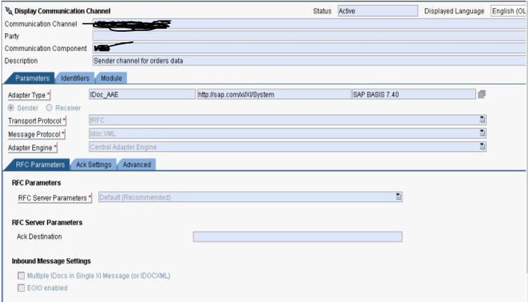
Configuring the Sender IDoc Adapter

Slide 20
Configuring the Receiver IDoc Adapter
Procedure:
The transport protocol is IDoc.
The message protocol is IDoc.
The Adapter Engine is the Integration Server.
Under RFC Destination, enter the RFC destination of the receiver system.
Under Segment Version, specify which segments of the IDoc type are to be sent to the receiver system.
Under Interface Version, specify which function module must be called in the receiver system to transfer the data in the relevant format. Function module calls for the interface versions are placed in the tRFC queue.
Enter the port that the IDoc adapter uses to receive the IDoc metadata. The port definition uses an RFC destination to receive the IDoc structure by RFC.

Slide 21
Under SAP Release, specify the current release of the receiver system. To convert the data from IDoc XML to IDoc format, the receiver IDoc adapter requires the IDoc metadata. If the IDoc metadata is not available, it will be loaded from the receiver system.
If function module IDOC_INBOUND_IN_QUEUE is to be used, choose Queue Processing.
If the original partner from the IDoc request message is to be used for acknowledgments, choose Restore Original Parties for Acknowledgments. This means you no longer have to maintain the alternative identifiers (for party conversion) in the Integration Directory.
To reassign the communication party to the IDoc partner, choose Apply Control Record Values from Payload. This is only possible for systems that are not logical systems. If you do not set the indicator, all combinations of communication parties and communication components are handled as communication components without party.
If the IDoc XML structure contains a control record during outbound processing on the Integration Server, it is rejected and created again by the IDoc adapter. If you want to include additional values in the control record, set the indicator and provide an appropriate mapping for the values.

Slide 22
If you want to take the sender of the message from the payload and not from the configuration information in the Integration Directory, choose Take Sender from Payload. If you do not set the indicator, the information is taken from the configuration in the Integration Directory.
If you want to take the receiver of the message from the payload and not from the configuration information in the Integration Directory, choose Take Receiver from Payload. If you do not set the indicator, the information is taken from the configuration in the Integration Directory.If you set both of the above indicators, you do not require a heading mapping and do not need to set the alternative identifiers.However, you must ensure that the SNDPRN, SNDPRT, RCVPRN, and RCVPRT fields are set in the IDoc control record.

Slide 23
